Slide 1
Employee Data Analysis using Excel
STUDENT NAME: C. KEERTHIGA
REGISTER NO:202212031
DEPARTMENT:COMMERCE
COLLEGE:ANNAI THERASA ARTS AND SCIENCE COLLEGE THIRUKAZHUKUNDRAM

Slide 2
PROJECT TITLE
Employee Performance Analysis using Excel

Slide 3


AGENDA
Problem Statement
Project Overview
End Users
Our Solution and Proposition
Dataset Description
Modelling Approach
Results and Discussion
Conclusion
3/21/2024 Annual Review

Slide 4

PROBLEM STATEMENT
The HR department is seeking to develop an Excel-based system to analysis and evaluate employee performance across various departments and roles. With a dataset of 500 employees, the system needs to track key performance indicators such as sales numbers, customer satisfaction ratings, project completion rates, and quality metrics. The goal is to create a comprehensive dashboard that enables individual employee scorecards, departmental performance comparisons, and trend analysis over time. By identifying top performers and areas for improvement, the system aims to provide actionable insights for informed decision-making and targeted training initiatives, ultimately enhancing employee performance and driving business growth.

Slide 5

PROJECT OVERVIEW
Objective:
Design and develop an Excel-based system to track, evaluate, and visualize employee performance across various departments and roles.
Scope:-
Develop an Excel dashboard to track key performance indicators (KPIs)
Create individual employee scorecards and departmental performance comparisons
Enable trend analysis over time (quarterly and annually)
Identify top performers and areas for improvement
Provide data-driven insights for informed decision-making and targeted training initiatives
Deliverables:-
Excel-based employee performance analysis system
Comprehensive dashboard with data visualizations
Individual employee scorecards and departmental reports
Trend analysis and performance insights

Slide 6

WHO ARE THE END USERS?
Objective: Design and develop an Excel-based system to track, evaluate, and visualize employee performance across various departments and roles.
Scope:- Develop an Excel dashboard to track key performance indicators (KPIs)
Create individual employee scorecards and departmental performance comparisons
Enable trend analysis over time (quarterly and annually)
Identify top performers and areas for improvement
Provide data-driven insights for informed decision
making and targeted training initiatives
Deliverables:
Excel-based employee performance analysis system
Comprehensive dashboard with data visualizations
Individual employee scorecards and departmental reports
Trend analysis and performance insights

Slide 7

OUR SOLUTION AND ITS VALUE PROPOSITION
"Empower Excel" A comprehensive Excel-based employee performance analysis and management system.
Value Proposition:
"Transform your employee performance management with Empower Excel, a powerful and user
-friendly Excel-based solution. Easily track, analysis, and visualize performance data, identify top performers, and pinpoint areas for improvement. Make data-driven decisions, enhance employee development, and drive business growth with Empower Excel's robust features and benefits.
Key Features:
Comprehensive performance dashboard
Automated data tracking and reporting
Customizable KPIs and metrics
Individual employee scorecards and departmental comparisons
Trend analysis and predictive insights6. Integration with existing HR systems

Slide 8
Dataset Description
The dataset for Empower Excel consists of employee performance records, spanning across various departments and roles, with a total of 500 employees. The dataset includes key performance indicators (KPIs) such as sales numbers, customer satisfaction ratings, project completion rates, and quality metrics, tracked over a period of 12 months. Additional data points include employee demographics, job titles, departments, and tenure, providing a comprehensive view of the workforce. The dataset is structured into separate sheets for each KPI, with columns for employee ID, name, department, and performance metrics, allowing for easy filtering, sorting, and analysis in Excel. This robust dataset enables HR professionals and managers to gain actionable insights, identify trends, and make data-driven decisions to enhance employee performance and drive business growth.

Slide 9

THE "WOW" IN OUR SOLUTION
The "WOW" factor in Empower Excel lies in its cutting-edge, automated, and intuitive features that transform employee performance analysis from a tedious, manual process to a seamless, data-driven experience. With Empower Excel, HR professionals and managers can effortlessly track and visualize performance metrics in real-time, identify top performers and areas for improvement, and receive predictive insights to inform strategic decisions. The system's advanced analytics and AI-powered recommendations enable organizations to proactively address performance gaps, optimize talent development, and drive business growth. Moreover, Empower Excel's user-friendly interface and customizable dashboards ensure that users can easily navigate and leverage the system's capabilities, making it an indispensable tool for employee performance management.
3/21/2024 Annual Review
9

Slide 10
MODELLING
Data Preparation: Clean, transform, and format the dataset for analysis.
KPI Selection: Identify relevant Key Performance Indicators (KPIs) for analysis, such as sales numbers, customer satisfaction ratings, and project completion rates.
Weightage Assignment: Assign weights to each KPI based on organizational priorities and objectives.
Scoring Model: Develop a scoring model to calculate employee performance scores based on KPIs and weights.
Benchmarking: Establish benchmarks for performance evaluation, such as average, median, or top performer scores.
Trend Analysis: Analysis performance trends over time to identify areas of improvement.
Predictive Modelling: Apply predictive analytics to forecast future performance and identify potential risks or opportunities.
Dashboard Creation: Design and develop interactive dashboards to visualize performance data and insights
10

Slide 11
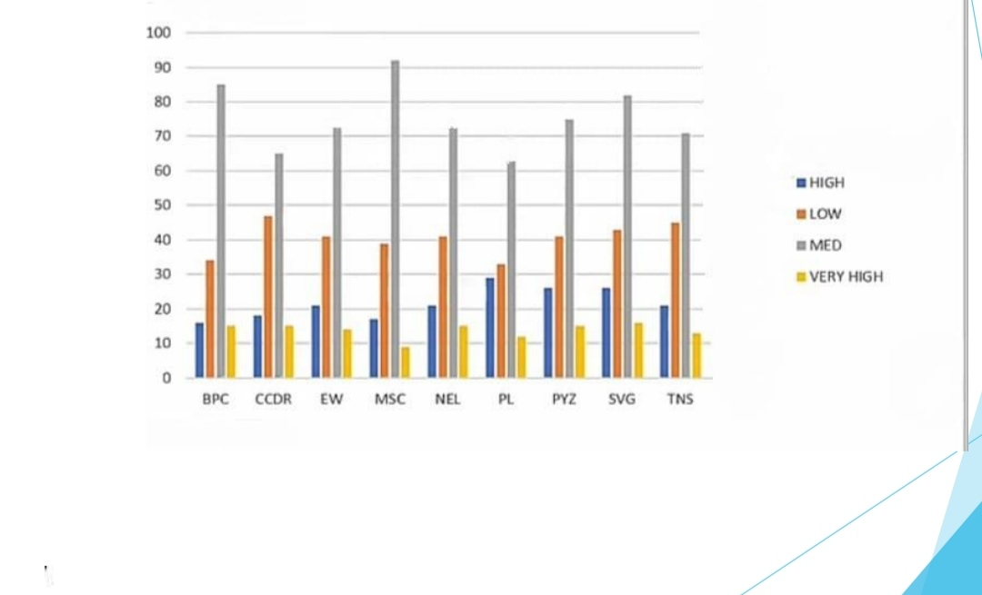
RESULTS
11

Slide 12
conclusion
In conclusion, Empower Excel's Employee Performance Analysis using Excel provides a powerful and intuitive solution for organizations to optimize their workforce performance. By harnessing the capabilities of Excel, Empower Excel enables HR professionals and managers to effortlessly track, analysis, and visualize employee performance data, gaining actionable insights to inform strategic decisions. With its comprehensive dashboard, automated reporting, and predictive analytics, Empower Excel streamlines employee performance management, enhances talent development, and drives business growth. By adopting Empower Excel, organizations can unlock the full potential of their employees, foster a culture of high performance, and achieve sustainable success in an ever-evolving business landscape.

